Slide 1
DETERMINATION OF TEMPERATURE OF STARS IN M12 CLUSTER AND HENCE VERIFY WEIN’S CONSTANT

Slide 2
GROUP MEMBERS
1.AMAL MOHANDAS
2.SELVA
3.SUMAYYA C.P
4.VASEEM SHUHAIB K
5.ZAINA SHAHLA
UNDER THE GUIDANCE OF
NASEEF MOHAMMED PN
ASSISTANT PROFESSOR
DEPARTMENT OF PHYSICS
FAROOK COLLEGE,CALICUT

Slide 3
CONTENT
1.INTRODUCTION
2.EXPERIMENTAL SOFTWARE
3.ANALYSING M12 CLUSTER
4.CALCULATING TEMPERATURE
5.OBTAINING WAVELENGTH
6.OBTAINING WEIN’S CONSTANT
7.RESULT AND CONCLUSION
8.REFERENCE

Slide 4
INTRODUCTION
1)Astronamy,Astrophysics
2)M12 cluster
3)For collection of data
(Iraf,ds9,libereoffice calc,Qti plot)
4)wein’s displacement law
λmax = b / T
λpeak T =2.87 × 10-3 m k

Slide 5
EXPERIMENTAL SOFTWARE
*Fits image file of M12 cluster
*Iraf
*Ds9

Slide 6
ANALYSING M12 CLUSTER
1)location and characteristics
2)Analysis using IRAF
3)FWHM value
4)obtain v and b values

Slide 7

CALCULATING TEMPERATURE
Obtain v and b values
Color index (B-V)
Equation to calculate temperature,

Slide 8
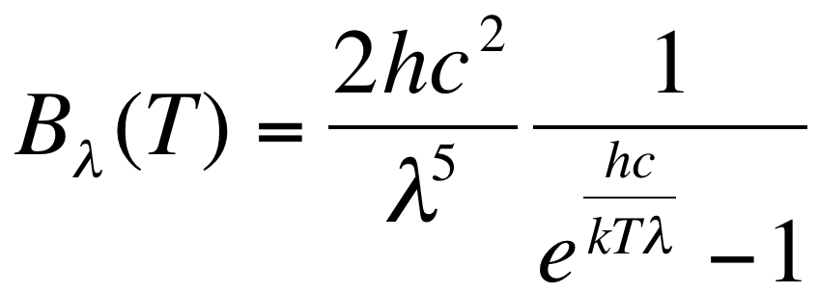
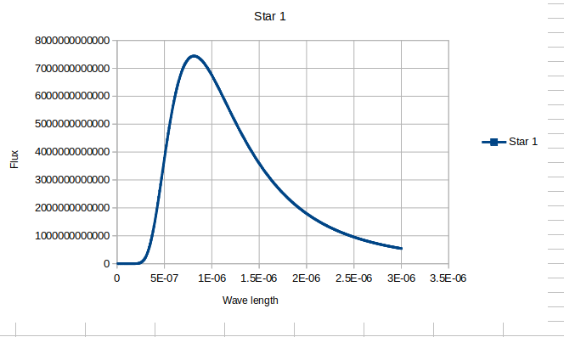
DETERMINATION OF WAVELENGTH
Equation of flux,
wavelenth-temperature graph

Slide 9
OBTAIN WEIN’S CONSTANT
1Weins law
2Weins constant (2.87 × 10-3 m k)
3Graph of log p and log lambda peak
4 Y =mx +c
5 weins constant =lambda peak *T

Slide 10
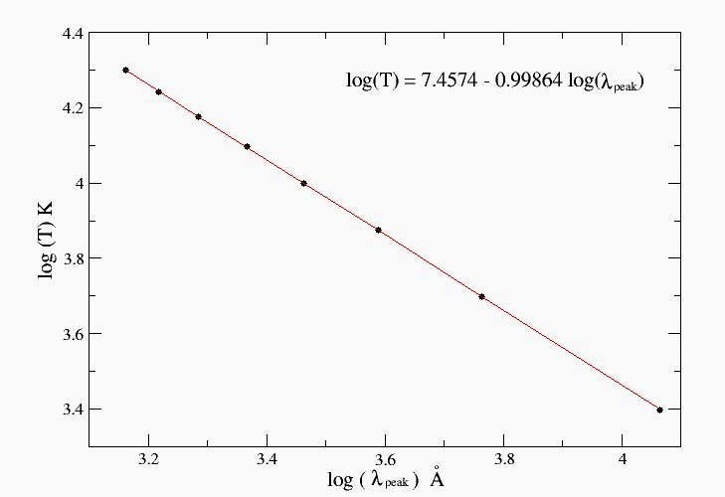
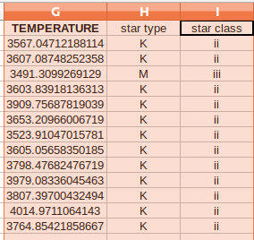
RESULT
Star classification
Wiens graph
λpeakT = 2.95*10^-3 mk.

Slide 11
Referrence
1)skynakas observatory. https://skinakas.physics.uoc.gr/en/index.php/research
2)Wikipedia.com

